Slide 1

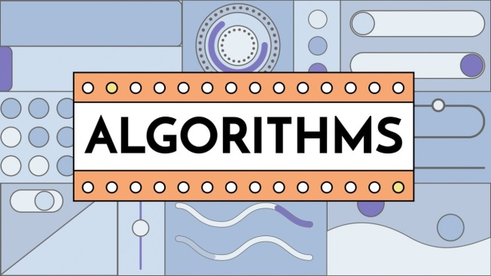
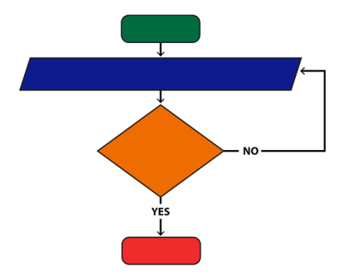
Algorithms & Flowcharts
2nd Semester Diploma Engineering Student
Presented by : SK Sahil
EduTech

Slide 2
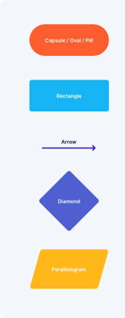

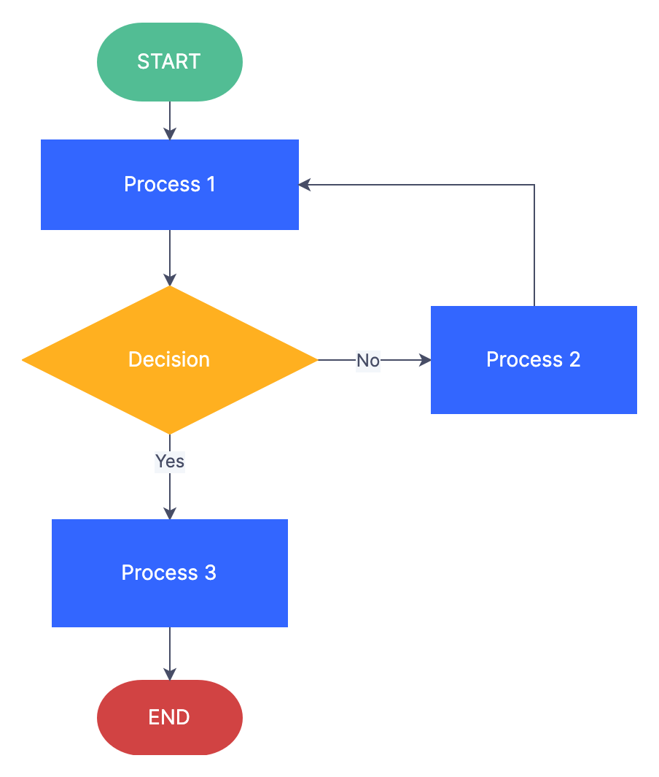
Agenda / Topics Covered
What is algorithm & flowchart?
Characteristics & Examples
Advantages & Disadvantages
Define symbols of flowchart
Solve 5 most important conceptual problems
Given 5 home task.
Practice PYQ’s
Revision previous class (very quickly)
→Bonus Tips (How to solve this kind of problem?)
Prepared by SK Sahil

Slide 3
CV / Resume
Readymade
Personal Information
Educational Qualification
Job/ Internship Experience
Skills
Extra Curricular Activities
Google Docx
Canva.com
Google Playstore (so many apps are available)
Prepared by SK Sahil

Slide 4
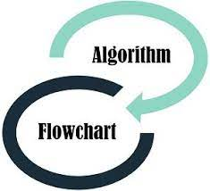

Terminologies
Algorithm
Flowchart
Pseudo code
Flowchart symbol
Prepared by SK Sahil
Agulo jantei hobe ai topic a command ante gele

Slide 5
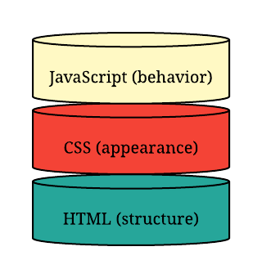




Gossiping
Algorithms is a subject
Algorithms & Flowcharts are not coding related things.

Slide 6
Algorithms
How to make Tea ?
For example:
Small parts
Logically Arrange
Start
Take Bowl with water
Gas Stove On
Add Sugar, milk & tea leaves
Boil
Refine
Exit/End
Def^{n}
step-by-step procedure to solve a particular problem.
Prepared by SK Sahil

Slide 7

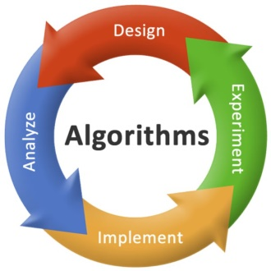
What is Algorithms?
An algorithm is a step-by-step procedure used to solve a particular problem.
Examples of Algorithms:
Sorting Algorithm
Searching Algorithms
Characteristics / Features of Algorithms:
Input
Output
Finiteness
Definiteness
Completeness
The algorithm is written by natural English language.
Prepared by SK Sahil

Slide 8
Advantages of Algorithms
It is easy to understand because it is written by simple English language.
Algorithms provide a systematic approach to problem-solving and can lead to efficient and accurate solutions.
They can be easily implemented in computer programs and automated systems, saving time and reducing errors.
Algorithms can be optimized and improved over time to further increase efficiency and accuracy.
Pros
Efficiency, Accuracy, Scalability
Disadvantages of Algorithms
Cons
Complexity
Developing and implementing algorithms can be time-consuming and resource-intensive.
Some algorithms may not be suitable for certain types of problems or data sets, leading to inaccurate or incomplete solutions.
The design and implementation of algorithms may require specialized knowledge and skills, limiting their accessibility to non-experts.
Prepared by SK Sahil

Slide 9
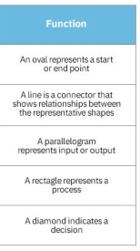
Flowchart Symbols:
Start / End
Arrows
Input / Output
Process
Decision
Prepared by SK Sahil

Slide 10
Flowchart
How to make Tea ?
For example:
Flowchart:-
start
Small parts
Logically Arrange
Def^{n}
Input: Bowl & water, Sugar, milk, tea
It is a Diagram to represent solutions of problems.
Boiling
Algorithm:-
Start
Take Bowl with water
Gas Stove On
Add Sugar, milk & tea leaves
Boil
Refine
Exit/End
Output: Tea
End
Prepared by SK Sahil

Slide 11
What is Flowcharts?
It is a Diagram to represent solutions of problems.
Examples of Flowcharts:
Data flow diagram
Workflow diagram:
Characteristics / Features of Flowcharts:
Symbolic representation
Logical flow
Clarity
Standardization
The flowchart is always drawn by oval, rectangle, parallelogram, diagram & arrow shapes.
Prepared by SK Sahil

Slide 12
Advantages of Flowcharts
Pros
Efficiency, Accuracy, Scalability
Analysis becomes effective.
Helps Identify Specific Steps.
Debugging becomes possible.
Helps Solve Problems.
Communicates Ideas Quickly.
Disadvantages of Flowcharts
Cons
Complexity
Difficult to understand for people who don't know flowchart symbols
Logic Complexity
It's a time-consuming process
Prepared by SK Sahil

Slide 13
Difference Btn. Algorithm & Flowchart
How to make Tea ?
start
Start
Take Bowl with water
Gas Stove On
Add Sugar, milk & tea leaves
Boil
Refine
Exit/End
Input: Bowl & water, Sugar, milk, tea
Boiling
Output: Tea
End

Slide 14
Write the Algorithm & Flowchart of the given problem
Sum of two numbers
Flowchart:-
start
Algorithm:-
Start
Input numbers a & b
Calculate sum= a + b
Print sum
Exit
Input: a,b
Sum=a+b
Inputs:
a,b
Output:
Sum
Print Sum
End
Prepared by SK Sahil

Slide 15
Write the Algorithm & Flowchart of the given problem
Calculate Simple Interest
Flowchart:-
start
Algorithm:-
Start
Input Principal(P), Rate(R),Time(T)
Calculate SI= (P*R*T)/100
Print SI
Exit
Input: P,R,T
SI=(P*R*T)/100
Print SI
End
Prepared by SK Sahil

Slide 16
Convert Celsius to Fahrenheit

Slide 17
Convert Celsius to Fahrenheit

Slide 18
Write the Algorithm & Flowchart of the given problem
Find Maximum (max^{m}) of two numbers.
Algorithm:-
Start
Input a, b
If a>b do
print a
else
print b
4. Exit
Prepared by SK Sahil

Slide 19
Write the Algorithm & Flowchart of the given problem
Find Maximum (max^{m}) of three numbers.
Nested
Algorithm:-
Start
Input a, b, c
If a>b do
if a>c do
print a
else
print c
else
if b>c do
print b
else
print c
4. Exit
Prepared by SK Sahil

Slide 20
Flowchart:-
start
Draw Flowchart, Maximum (max^{m}) of three numbers.
Input: a,b,c
Is a>b?
YES
NO
Is a>c?
NO
NO
Is b>c?
YES
YES
Print a
Print c
Print b
End
Prepared by SK Sahil

Slide 21
Write the Algorithm & Flowchart of the given problem
Find if a number is Prime or not.
Prime No:
2,3,5,7,11,13,17
Def: divisible by 1 & that particular no.
Flowchart:-
Algorithm:-
Modulo: %
Def: Remainder find
Start
Input n
Let div=2
While div < n do
if n % div == 0 do
print “Not Prime”
Exit
else
div = div + 1
print “Prime”
5. Exit
Prepared by SK Sahil

Slide 22
Flowchart:-
start
Draw Flowchart , if a number is Prime or not.
Input: n
Let div=2
NO
Is div<n?
YES
Let div=2
Is div<n?
NO
Print SI
YES
Print Not Prime
End
Prepared by SK Sahil

Slide 23
Write the Algorithm & Flowchart of the given problem
Sum of first n natural numbers
Algorithm:-
Start
Input n
Let val = 1 & sum=0
While val <= n do
sum = sum + val
val = val + 1
Print sum
Exit
Prepared by SK Sahil

Slide 24
Flowchart:-
start
Draw Flowchart, Sum of first n natural numbers
Input: n
Let val=1, sum=0
Val <= n
YES
Sum= sum+ val
Val=val+1
NO
Print SI
End
Prepared by SK Sahil

Slide 25
Home task
FLOWCHART QUESTIONS
Note: Please try to write the algorithms / pseudo code for these questions too. In the solution sheet
We have given flowcharts for all questions.
Question 1:
Flowchart to calculate the area of a circle.
Question 2:
Flowchart to find the greatest from 2 numbers.
Question 3:
Flowchart to print the Even numbers between 9 and 100
Question 4:
Flowchart for calculating the average from 25 exam scores.
Question 5:
Find all the roots of a quadratic equation ax² + bx + x = 0
I will discuss this solution whenever start the JavaScript class.
Prepared by SK Sahil

Slide 26
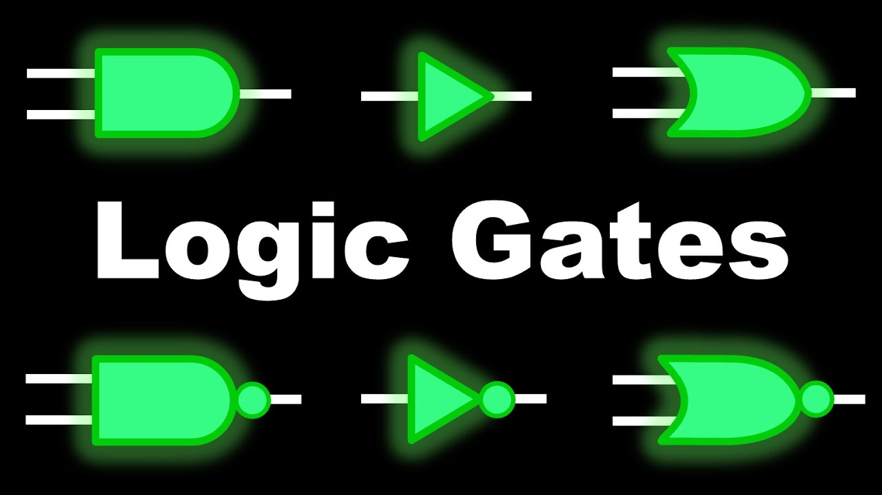
Full Revisions
Circuit Diagrams
0 = OFF
1 = ON
AND Gate opposite NAND Gate
OR Gate Opposite NOR Gate
Minimum inputs line should be 2
Always final output line should be 1
NOT Gate= inverter Gate

Slide 27
Full Revisions
Truth Tables
INPUT OUTPUT
AND Gate OR Gate NOT Gate NAND Gate NOR Gate XOR Gate XNOR Gate NOT Gate
A | B | F=A.B | F=A+B | F=A’ | F=(A.B)’ | F=(A+B)’ | F=A + B | F=(A + B)’ | F=B’
0 | 0 | 0 | 0 | 1 | 1 | 1 | 0 | 1 | 1
0 | 1 | 0 | 1 | 1 | 1 | 0 | 1 | 0 | 0
1 | 0 | 0 | 1 | 0 | 1 | 0 | 1 | 0 | 1
1 | 1 | 1 | 1 | 0 | 0 | 0 | 0 | 1 | 0
0 = OFF
1 = ON
AND Gate opposite NAND Gate
OR Gate Opposite NOR Gate
Minimum inputs line should be 2
Always final output line should be 1
NAND = NOT + AND Gate
NOR = NOT + OR Gate
XOR = Exclusive- OR Gate
XNOR= Exclusive- NOR Gate
NOT Gate= inverter Gate
Nije banao same(Try yourself) ,when input is 3
Prepared by SK Sahil

Slide 28
PYQ (Previous Year Ques)
Define Algorithms . (with examples)
Define Flowcharts. (with examples)
Draw the Flowchart symbol with name & function.
What are the advantages & disadvantages of Algorithms. (Pros & Cons)
What are the advantages & disadvantages of Flowcharts. (Pros & Cons)
Difference between Algorithms & Flowcharts.
Mathematical concept related problems ask (ami je 5+5 ta problem koriyechi ogulo jodi prochur practice kore concept bujhe jaw then tumi any kind of problems solve korte parbe)
Check Answers the Previous Slides
Prepared by SK Sahil

Slide 29
How to solve easily this kind of problems in exam?
Practice each problems minimum 5 times
Whenever you faced any problem ask your tutor
Revision so many times
Command (10 problems)
Attend revision class & exam
Prepared by SK Sahil

Slide 30

Thank You for joining this class.
“You can never understand everything. But, you should push yourself to understand the system.”
~Creator of Node.js
consistency
Hard Work
Output= Consistency + Hard Work + Right Direction= Success
Right Direction
OR Gate
Prepared by SK Sahil

